Slide 1
Hunt the Trojans
by Jonathan Ong, Ran Gross, and Quanjie Geng

Slide 2
Summary
An interactive cat and mouse Android app
Equipments
Server (Parse)
Android devices
Communication Methods
Wi-Fi, Cellular Data, Bluetooth

Slide 3
Game Logic
A player can either create a new game or join an existing game.
The player created the game is the cat and the players who joined the game are the mice
Cat and mice can request for the locations of everyone that is near them within a certain range
Locations are served once per 60 seconds for minute ping which both cat and mice have.
cat has a super ping that allows a request for locations once every 30 seconds.
A mouse is captured by the cat if Bluetooth connection between their devices is established.
If the cat captures all the mice within the time limit, the cat wins. Otherwise the mice win.

Slide 4





Tracking Locations
Locations
Locations

Slide 5
Bluetooth Capture
Bluetooth

Slide 6
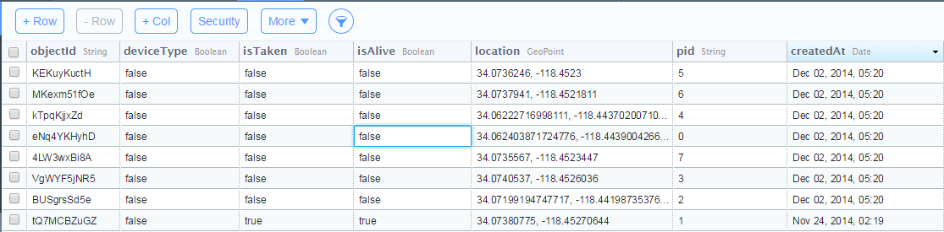
Parse
The server chosen to store data for the game.
Data stored includes:
ID of each device
whether a device ID is taken or not
whether the player is dead or alive
The locations of each device
Uses a set of queries to get data that was previously stored on the server to use for the map.

Slide 7
Google Map
A high level API that let us create a map
Move camera across the map
Zoom in or out
Draw markers
Display the device location

Slide 8
Bluetooth
Bluetooth is used for a cat to capture a mouse. The cat is the master of the piconet, and all mice are slaves of the piconet.
This Bluetooth capture is achieved through AsyncTask.

Slide 9
AsyncTask
AsyncTask will run in the background. It will constantly execute the thread’s run() function.
There are 3 asynchronous tasks in our code.
One for the Cat to make a connection for any connecting mouse.
Two for the mice: one to search for new devices and one to search through already paired devices

Slide 10
AsyncTask(cont.)
Bluetooth running in the background
Main thread

Slide 11
Ran’s Contribution
wrote the code that lets the app access the parse server.
organized the server inputs and defined the entries for the table
worked on the code for part of the game logic, different activity displays, layout of the app, and integrating the server code into the rest of the app.
For the map:
upload and download of location data that is currently allowed to be viewed
For the game logic:
upload and check conditions on the server to see if we can:
make a game
join a game
won/lost a game

Slide 12
Nero’s Contribution
Used the Google Map API to create a map in the app and support the following functionalities
Acquire the device’s current location through Wi-Fi or GPS
Update current location through a location listener
Draw a marker on the map with a location as input
Integrated Parse API for upload and download (from Ran) to support the following functionalities
Put the device’s current location on Parse as current location updates
Download the locations of other devices from Parse and draw markers for those locations upon player’s request

Slide 13
Jonathan’s Contributions
Bluetooth
Created classes and designed treads to run in background for both cat and mice to search for devices.
Configured the mouse to send data and the cat’s to receive.
Game Logic
Created each Activity and each View
Formatted each View function and layout
Created most of the “ping” functions.
Organized the activities, toasts, and Parse requests to update game state
Debugged many different states

Slide 14
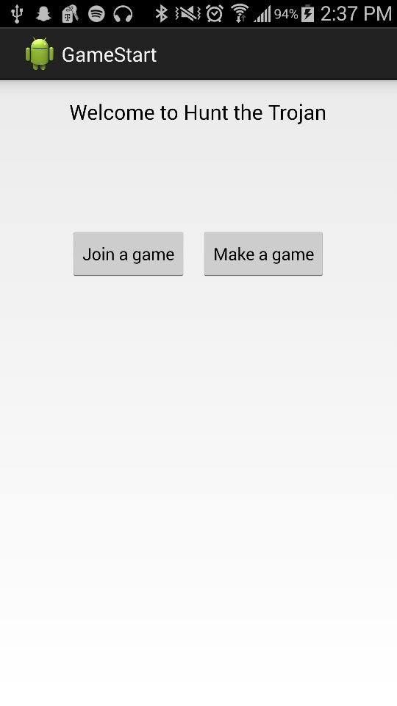
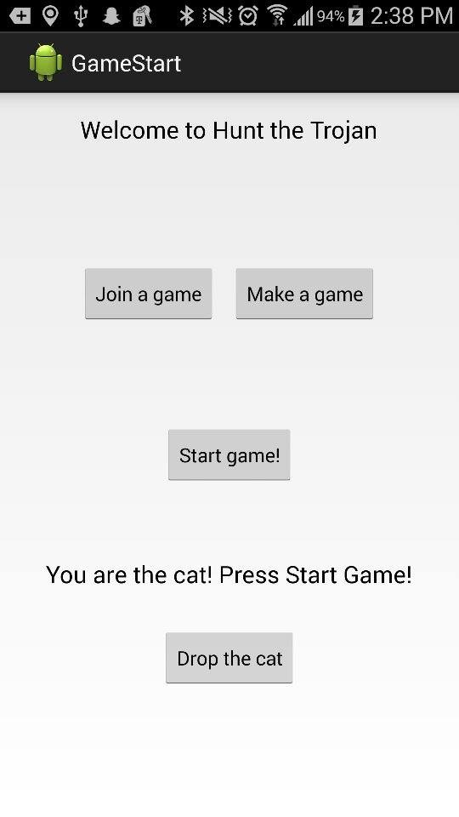
Screenshots - Start

Slide 15
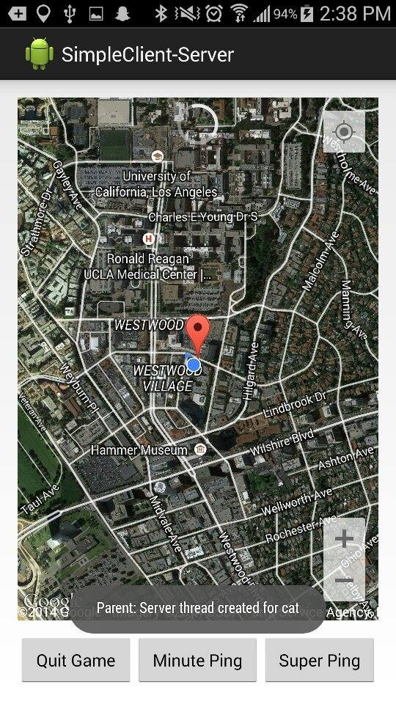
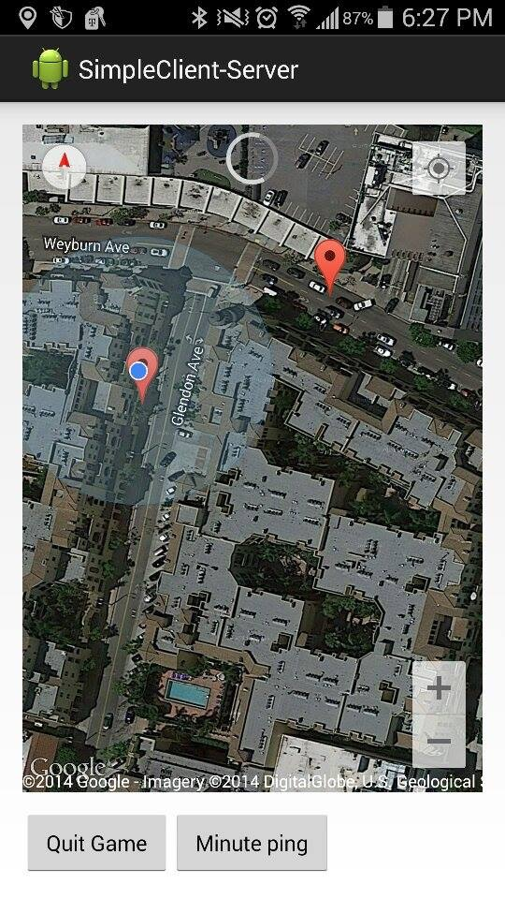
Screenshots - Map

Slide 16
Q&A
Thank you!

